Slide 1
Implanted Sensor IOT Project
Anapat Chairithinugull (Mew)

Slide 2
Motivations
Interest in a microcontroller
Seeking for out-of-class experiences
The project sounds fun!

Slide 3
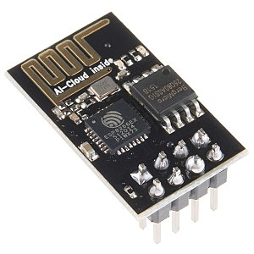
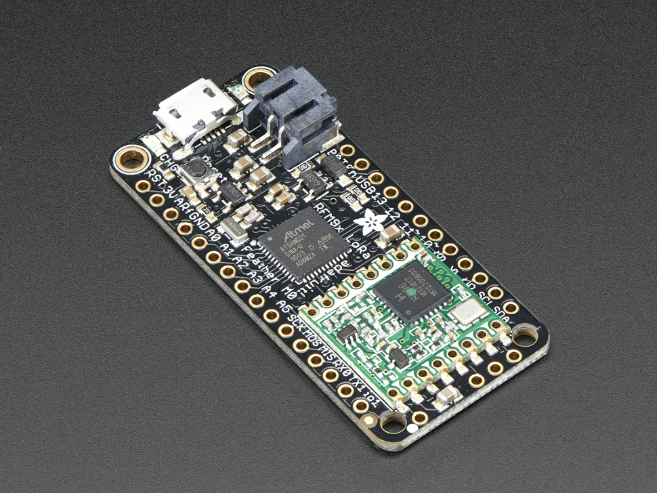
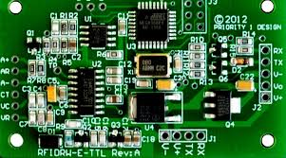
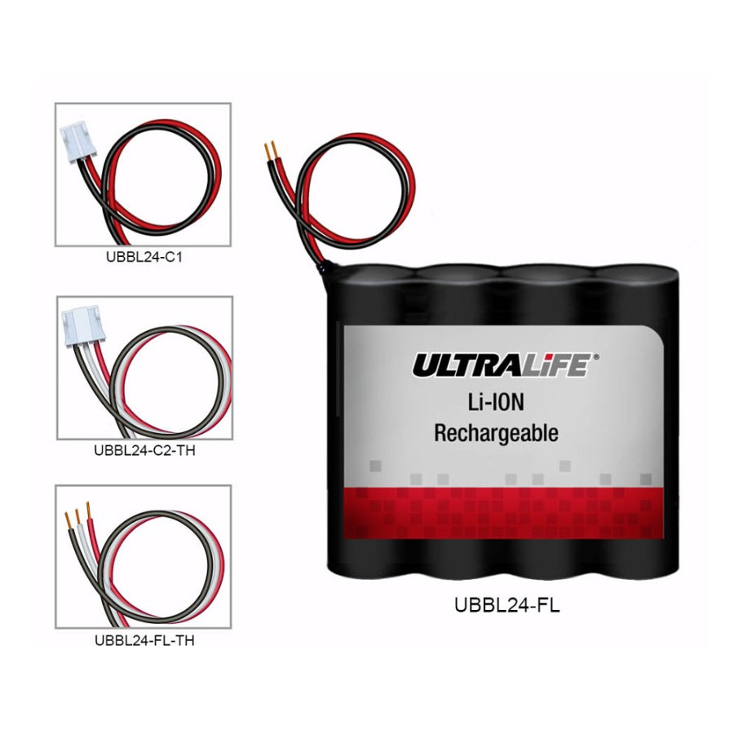
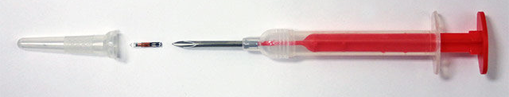
Overview
An IOT device that updates the temperature of cows in real-time on Thingspeak.com consisting of 5 main components:

Slide 4
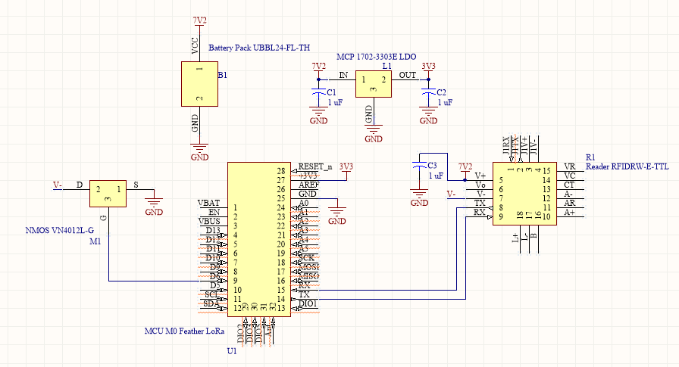
Picture please

Slide 5
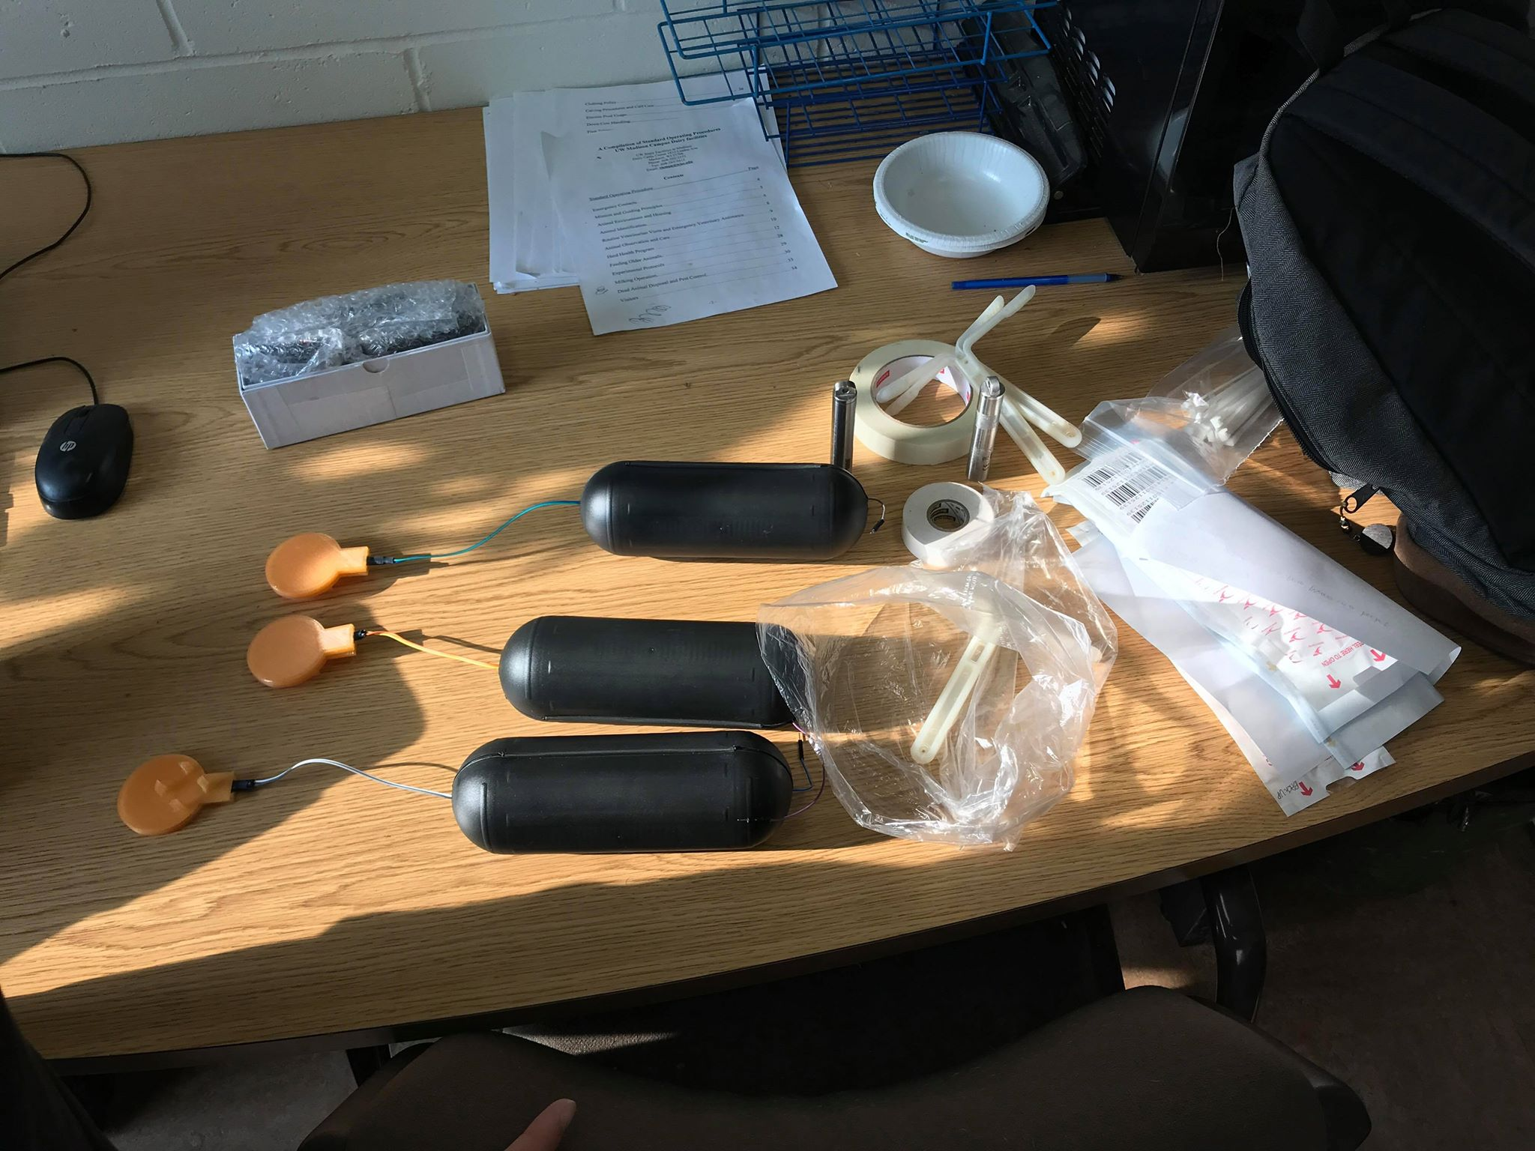

Slide 6
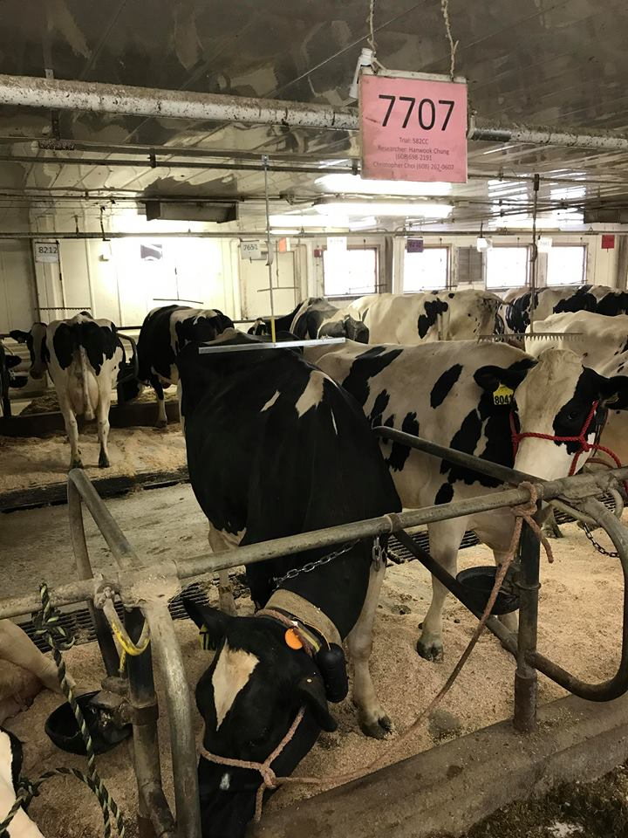
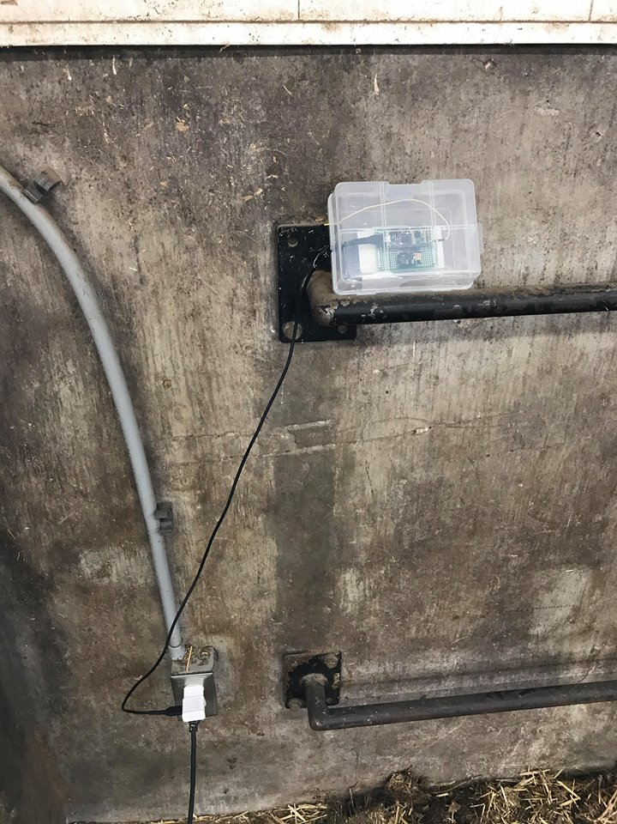

Slide 7
Timeline
Understand a RFID reader and a sensor
Code hard
Calibrate sensors
Integrate all components
Optimize the power consumption
Prototype a device
...Break some parts…
Finalize the device

Slide 8
Challenges
Forgetting Matlab
Understanding and using a RFID reader and a transponder (sensor)
Using new tools
Integrating and Prototyping the product
Limited angle and distance of reading

Slide 9
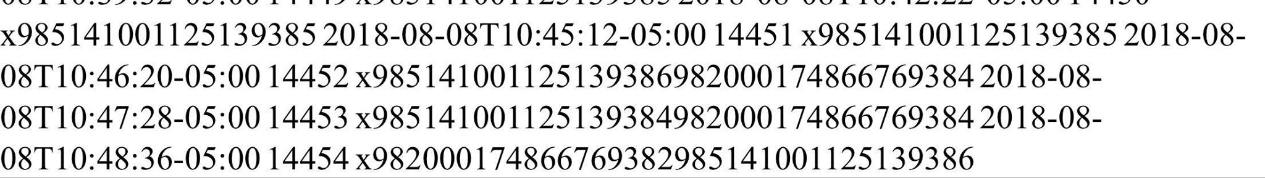
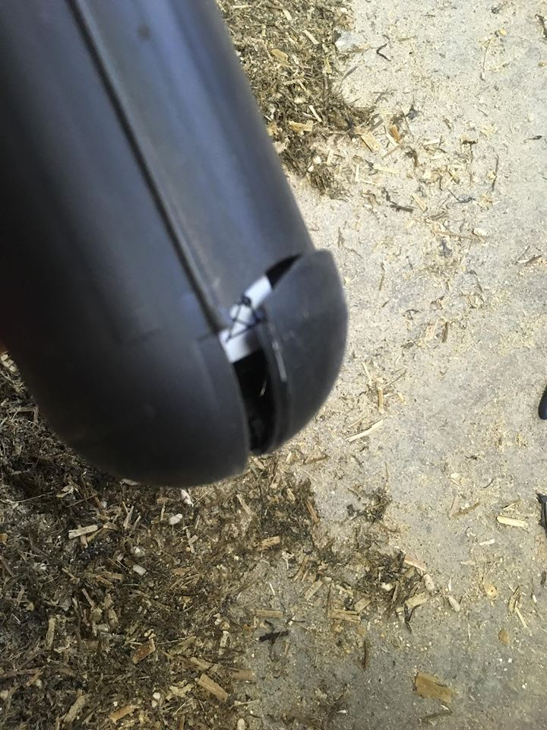
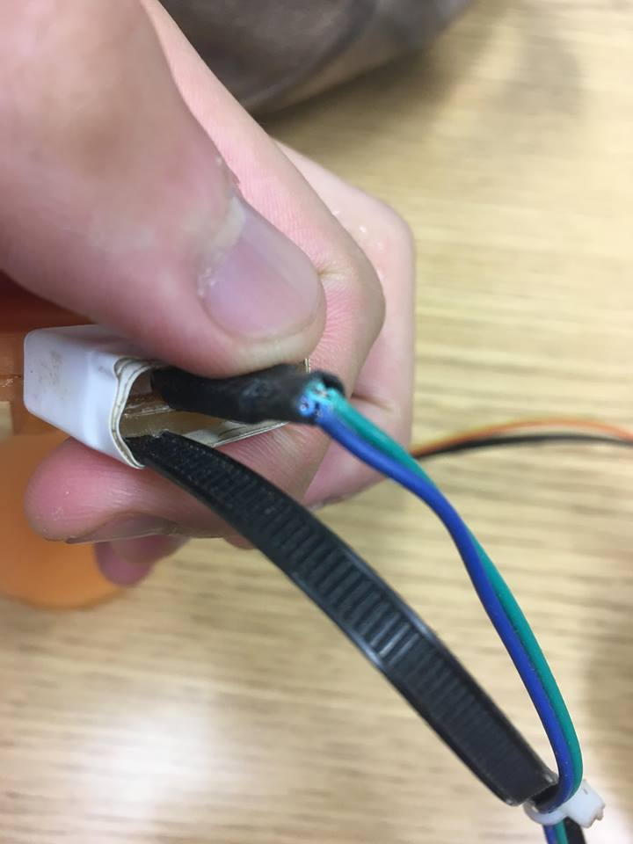
Other Challenges
Wire snapping
Interference
Cows’ movement

Slide 10
Project Results
Real-time temperature monitoring
Nearly wireless devices
Accurate data with a calibration
Sample every 30 seconds
Expected to last nearly 2 weeks

Slide 11
Further Improvement
Consume less power / Last longer
Reduce the size / become lighter
Read further
Optimize the code more
Create a better protocol
Reduce update delay

Slide 12
Personal Achievement
Recall Matlab
Learn how to
Read datasheets
Draw schematic with Altium
Integrate all components
Prototype a product
Learn how not to
Fry ICs
Probe DMM properly
Develop interpersonal skills
Get something done!

Slide 13
Thank you
Prof. Kim
Jingjie
Hanwook
Others

